Slide 1
ANALYSIS OF AUTISM SPECTRUM DISORDER DETECTION TECHNIQUES

Slide 2

Project Guide:
Mr.CH.S.S RAJESH PATNAIK
Assistant Professor
Project By:
G.LOKESH (pg212202022)
MCA 4th semester

Slide 3
CONTENTS
Abstract
Problem Statement
Existing System
Proposed System
Algorithms
Functional Requirements
Non-Functional Requirements
Use-case diagram
Sequence diagram
Sequence diagram
Activity diagram
Screens
Conclusion

Slide 4
ABSTRACT
Autism Spectrum Disorder (ASD) is a neurodevelopment disorder accompanied by sensory issues such as over-sensitivity or under-sensitivity to sounds, smells, or touch. Present-day Autism Spectrum Disorder (ASD) is gaining momentum faster than ever. Detecting autism traits through screening tests is very expensive and time-consuming. With the advancement of Machine Learning, autism can be predicted at quite an early stage. The main aim of this project is to analyze various Machine learning algorithms, used by various researchers like SVM (Support Vector Machine), Random Forest, Decision Trees, and Logistic Regression, Naïve bayes and compare the result based on their accuracy and efficiency.

Slide 5
PROBLEM STATEMENT
Autism is an integral neurodevelopment disorder that affects the functioning of the brain. It can occur at any age but usually occur in childhood; mostly children at the age of 2 or 3 have more chances of having ASD. It occurs due to the combination of both genetic and environmental factors. Autism is not an illness or a disease rather it is a neurological condition in which a child is unable to concentrate, think, learn, focus and solve problems. They find difficulty in explaining things through facial expressions or by making Gestures. It is the fastest-growing developmental disability in all over the world including India. According to Autism Centre for Excellence(ACE), 1 in 68 children is suffering from ASD. So, there is a need to diagnose this disability at an early age.

Slide 6
EXISTING SYSTEM
The existing systems use older machine learning algorithms like logistic regression, Decision Tree. Which are efficient in processing but fails to generate good accuracy. There are some systems which use Deep learning for autism detection but they require high processing power and are a bit complex to use.
Low accuracy
High complexity
Difficult to scales

Slide 7
PROPOSED SYSTEM
With the advancement of machine learning (ML), autism can be predicted at quite an early stage. The main aim of this project is to analyze various Machine learning algorithms, used by various researchers like SVM (Support Vector Machine), Random Forest, Decision Trees, Logistic Regression, and compare the result based on their accuracy and efficiency.
High accuracy
Low complexity
Easy to scale

Slide 8
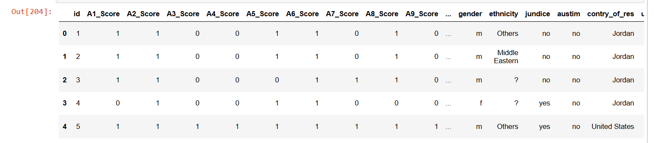
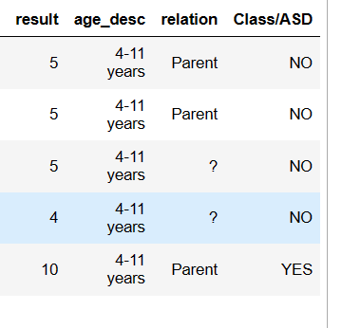
DATASET

Slide 9
ALGORITHMS USED
SUPPORT VECTOR MACHINE
The goal of the SVM algorithm is to create the best line or decision boundary that can segregate n-dimensional space into classes so that we can easily put the new data point in the correct category in the future. This best decision boundary is called a hyperplane.
SVM chooses the extreme points/vectors that help in creating the hyperplane. These extreme cases are called support vectors, and hence algorithm is termed a Support Vector Machine.

Slide 10
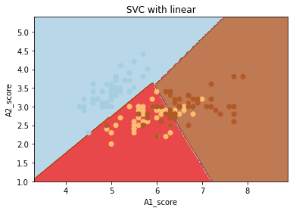
Example
Data Collection: Collect a dataset of individuals with and without ASD, and ensure that the dataset is balanced and representative.
Data Preprocessing: Preprocess the data by removing any missing or irrelevant features.
Feature Selection: Select the most relevant features for the SVM model to use in classification.
Splitting Data: Split the dataset into training and testing sets. This will allow you to train the model on a subset of the data.
Model Training: Train the SVM model on the training dataset using the selected features. This involves to minimize errors and maximize accuracy.
Prediction: Once the model is optimized, it can be used to predict whether an individual has ASD or not based on their input features.

Slide 11

ALGORITHMS USED
DECISION TREE
Decision Tree is the most powerful and popular tool for classification and prediction.
A Decision tree is a flowchart-like tree structure, where each internal node denotes a test on an attribute, each branch represents an outcome of the test, and each leaf node (terminal node) holds a class label.
Gini index

Slide 12
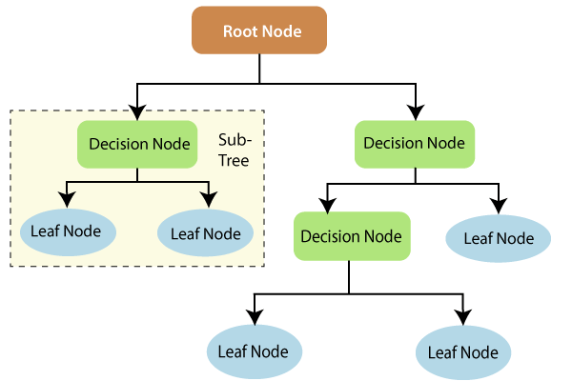
DECISION TREE EXAMPLE:-
1.Collecting data: Collect data about the individual, for eg: such as their age, gender. This data can be gathered through observation, medical assessments.
2.Identifying key features: Identify key features that are associated with ASD(A1 to A10 score). These might include social communication difficulties, repetitive behaviors, and other common symptoms.
3.Building the decision tree: Create a decision tree based on the key features identified in Step 2. For example, the decision tree might start with a question such as "Does the individual have difficulty with social communication?" If the answer is "yes," the decision tree might lead to further questions about specific social communication difficulties, such as difficulty understanding sarcasm or difficulty initiating conversations.
4.Validating the decision tree: Validate the decision tree using data from a separate set of individuals with and without ASD. This will help ensure that the decision tree accurately identifies individuals with ASD and minimizes false positives and false negatives.
5.Applying the decision tree: Apply the decision tree to new individuals who are suspected of having ASD. Use the decision tree to guide further assessments, diagnosis, and treatment planning.

Slide 13
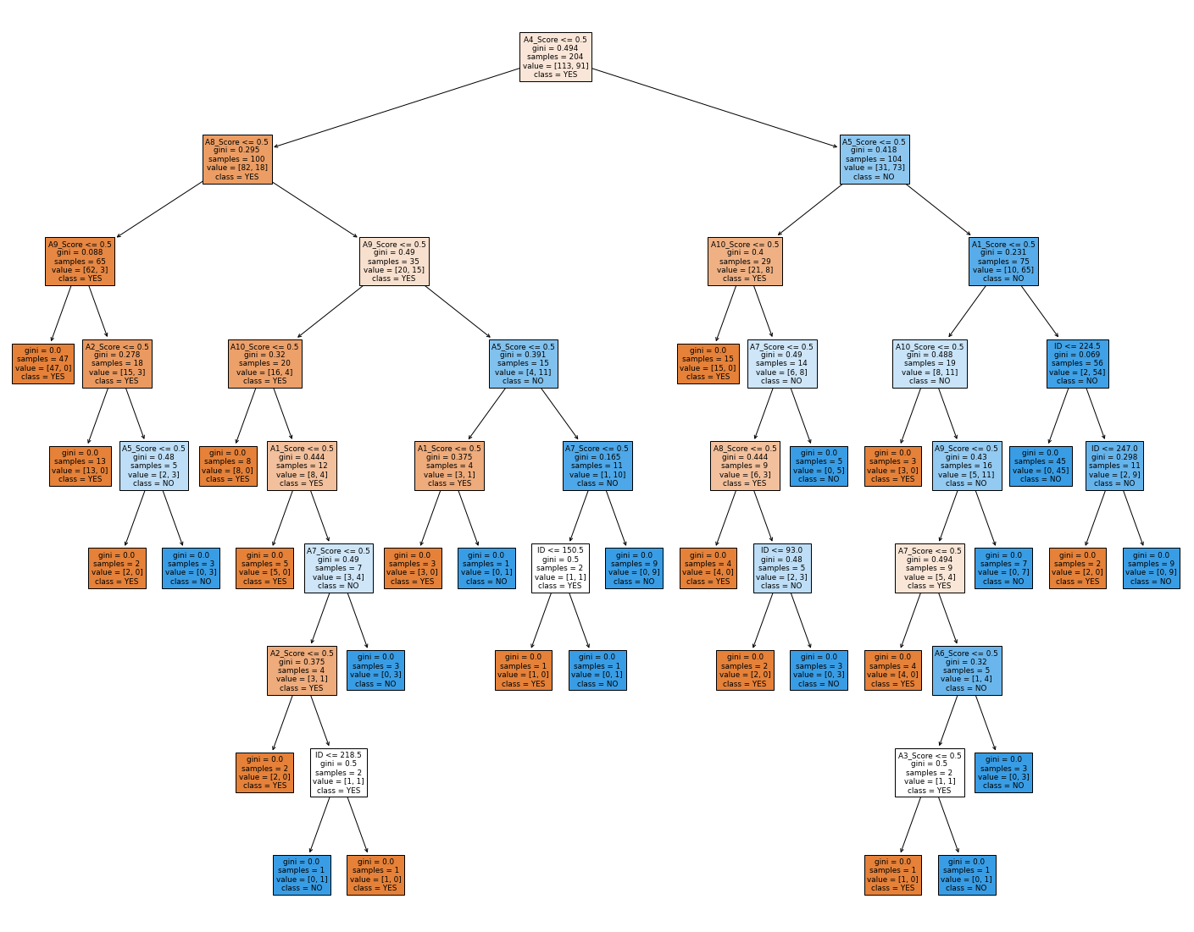

Slide 14
ALGORITHMS USED
RANDOM FOREST
It is based on the concept of ensemble learning, which is a process of combining multiple classifiers to solve a complex problem and to improve the performance of the model.
As the name suggests, "Random Forest is a classifier that contains several decision trees on various subsets of the given dataset and takes the average to improve the predictive accuracy of that dataset."
Instead of relying on one decision tree, the random forest takes the prediction from each tree and based on the majority votes of predictions, predicts the final output.
The greater number of trees in the forest leads to higher accuracy and prevents the problem of overfitting.

Slide 15
Data Preparation: First, you'll need to gather a dataset of ASD-related features and labels (i.e., whether or not each individual has ASD). You'll need to preprocess the data to clean it up and ensure it's in the correct format for analysis. You may also need to split the data into training and testing sets.
Feature Selection: Determine which features (i.e., variables or characteristics) are most important in predicting ASD. You may want to use feature importance or correlation analysis to identify the most relevant features.
Random Forest Model Training: Train a random forest model using the training data. In this step, you'll specify the number of trees to include in the forest and other hyperparameters that control how the model learns.
Model Evaluation: Evaluate the performance of the random forest model using the testing data. You can use metrics such as accuracy, precision, recall, and F1 score to assess how well the model is able to predict ASD.
Model Optimization: If the model isn't performing well, you can try tweaking the hyperparameters or using different feature selection methods to see if you can improve its accuracy.

Slide 16
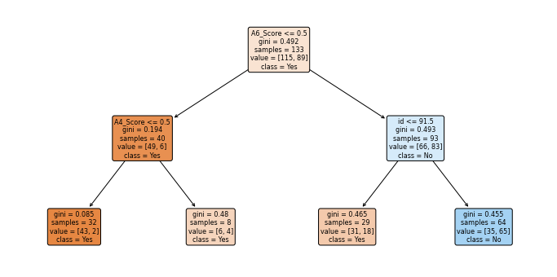
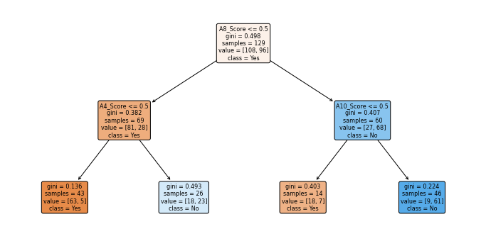
DecisionTreeClassifier(max_depth=2, max_features='auto', random_state=1608637542)
DecisionTreeClassifier(max_depth=2, max_features='auto', random_state=1273642419)

Slide 17
ALGORITHMS USED
LOGISTIC REGRESSION
Logistic regression predicts the output of a categorical dependent variable. Therefore the outcome must be a categorical or discrete value. It can be either Yes or No, 0 or 1, or true or False. But instead of giving the exact value as 0 and 1, it gives the probabilistic values which lie between 0 and 1.
Logistic Regression is much similar to Linear Regression except that how they are used. Linear Regression is used for solving Regression problems, whereas Logistic regression is used for solving the classification problems.

Slide 18
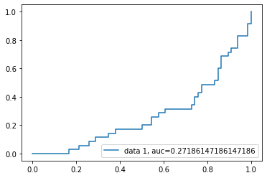
Collect data: Gather a dataset that includes information about people who have been with ASD and people who have not. The dataset should include variables such as age, gender, family history of ASD, and other relevant characteristics.
Prepare the data: Clean and preprocess the data to ensure it is ready for analysis. This includes removing any missing values.
Split the data: Divide the data into two subsets, a training set and a test set. The training set is used to build the logistic regression model, while the test set is used to evaluate the model's performance.
Build the logistic regression model: Fit a logistic regression model to the training set using the ASD diagnosis as the response variable and the other variables as predictors. The model will estimate the probability of a person having ASD based on their characteristics.
Evaluate the model: Use the test set to evaluate the performance of the model. Calculate metrics such as accuracy, precision, recall, and F1 score to assess how well the model is predicting ASD diagnosis.
Deploy the model: Once the model has been trained and evaluated, it can be used to predict ASD diagnosis for new individuals based on their characteristics.

Slide 19
System Configuration
Software Configurations:-
Operating System: Windows 10
Language: Python 3 .6+
IDE: Python Idle
Libraries Used: Pandas, NumPy , Sci-kit Learn, Matplotlib, Seaborn
Hardware Configurations:-
Processor- AMD Ryzen 3 3250U
RAM- 4GB (min)
Hard Disk- 128 GB
Key Board - Standard Windows Keyboard

Slide 20
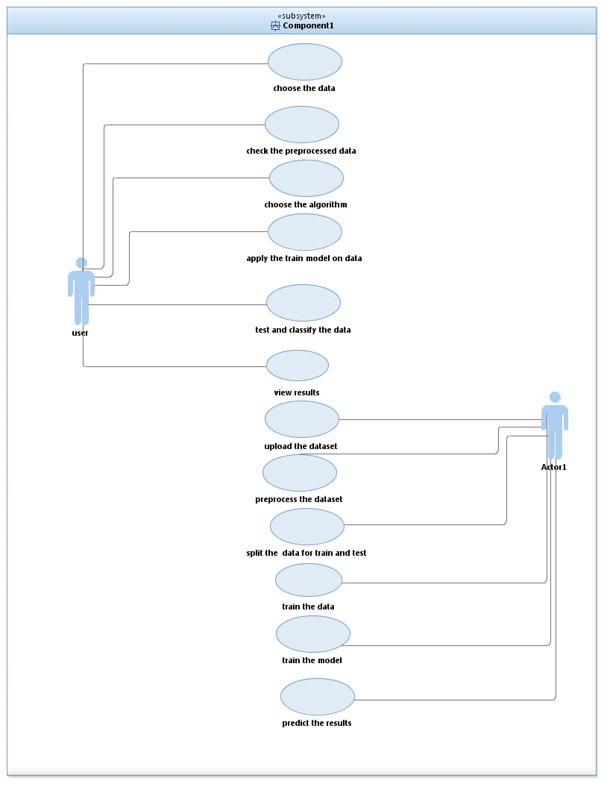
USECASE Diagram (user):

Slide 21
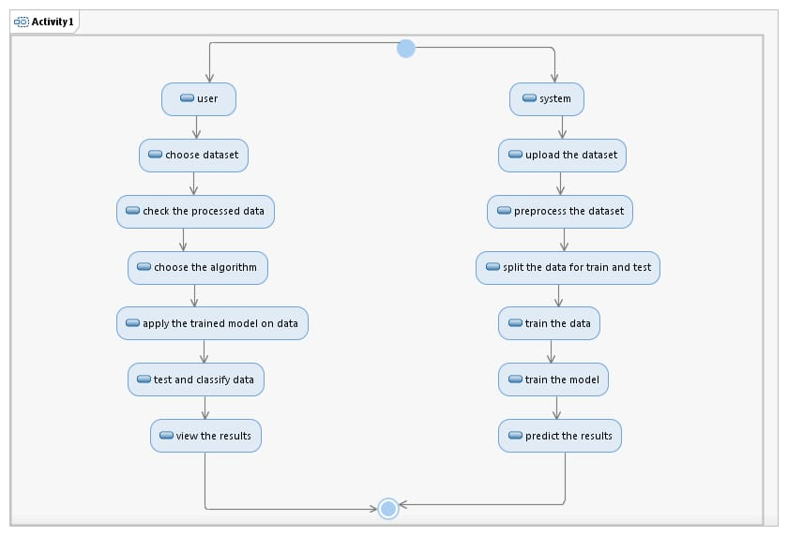
ACTIVITY Diagram:

Slide 22
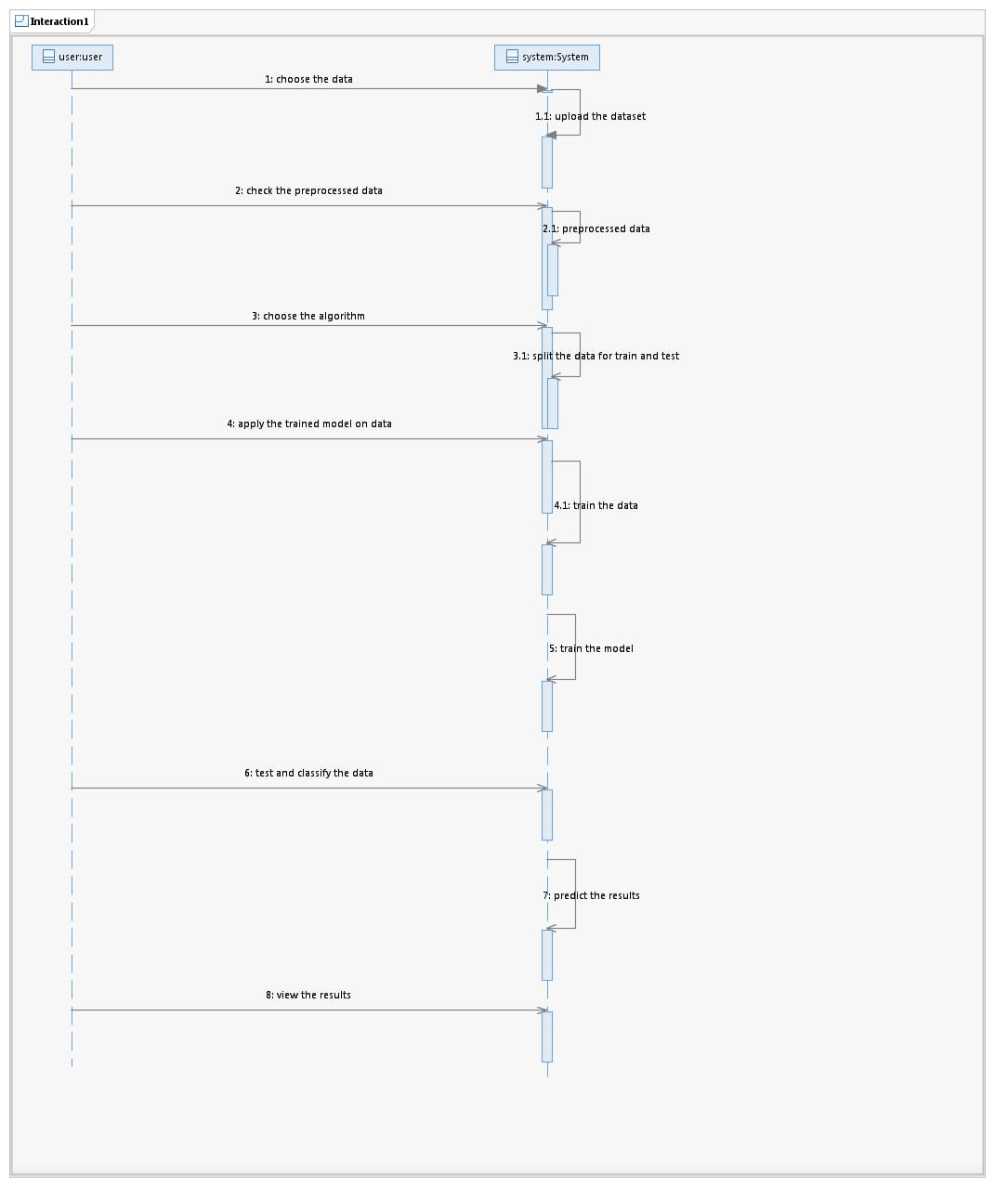
SEQUENCE Diagram:

Slide 23
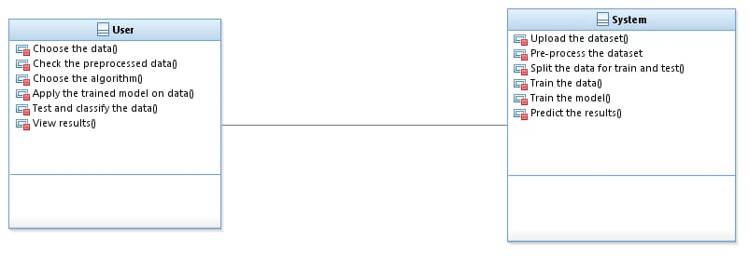
CLASS Diagram:

Slide 24
CLASS Diagram:

Slide 25
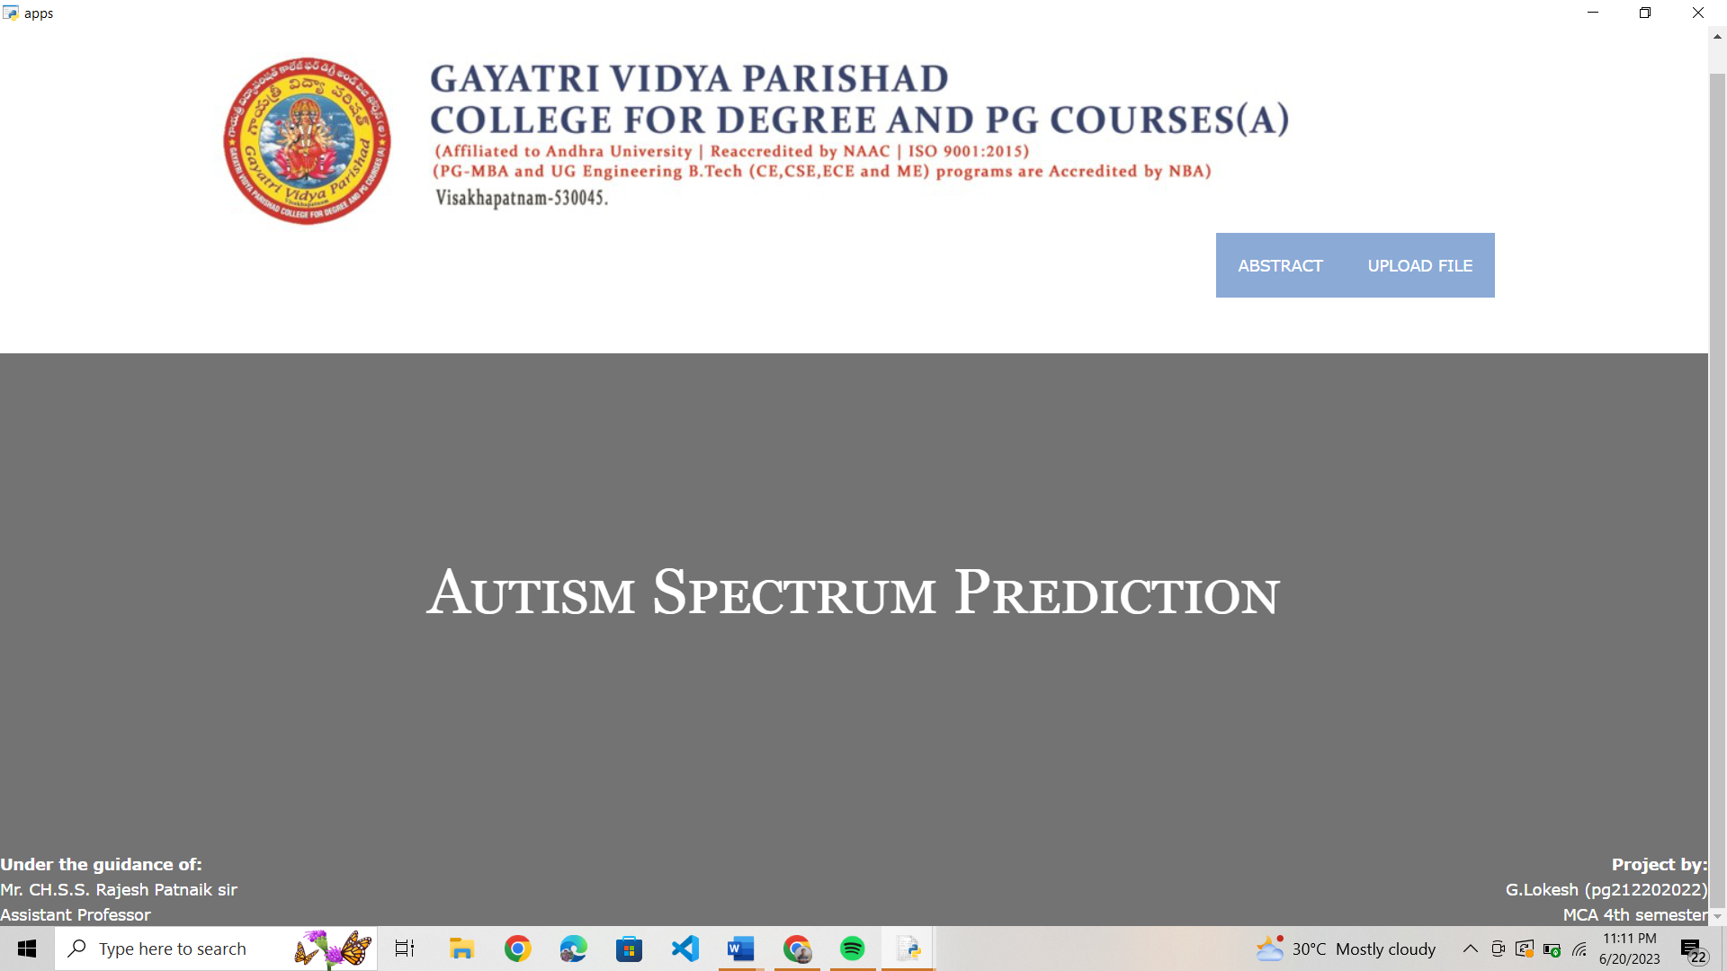
Home Page:-
Home page: It is the main page of the project, from here we can proceed to the next steps.

Slide 26
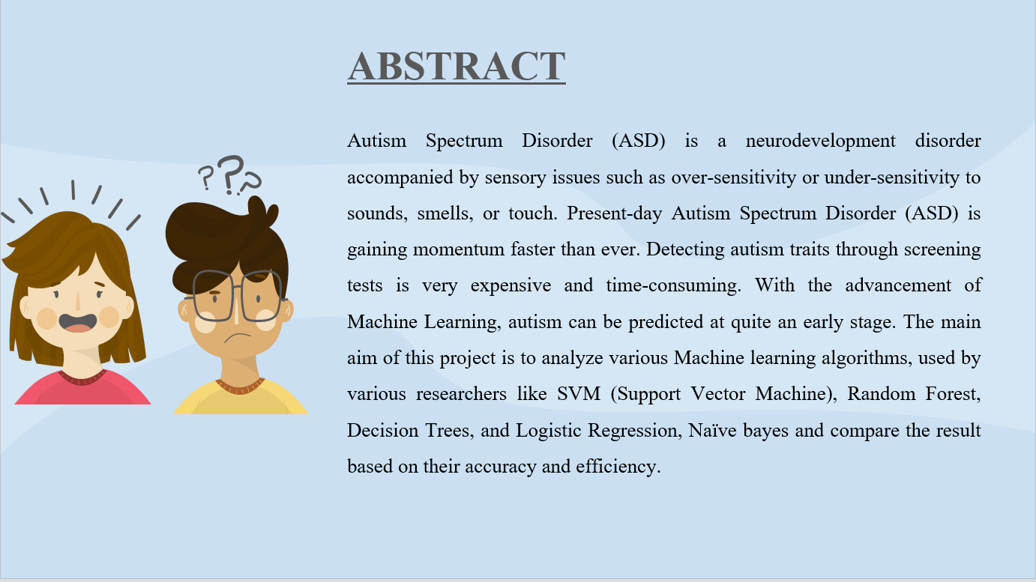
Abstract page:_
Abstract page: it is a one-paragraph summary of our project, gives a detailed information of the project.

Slide 27
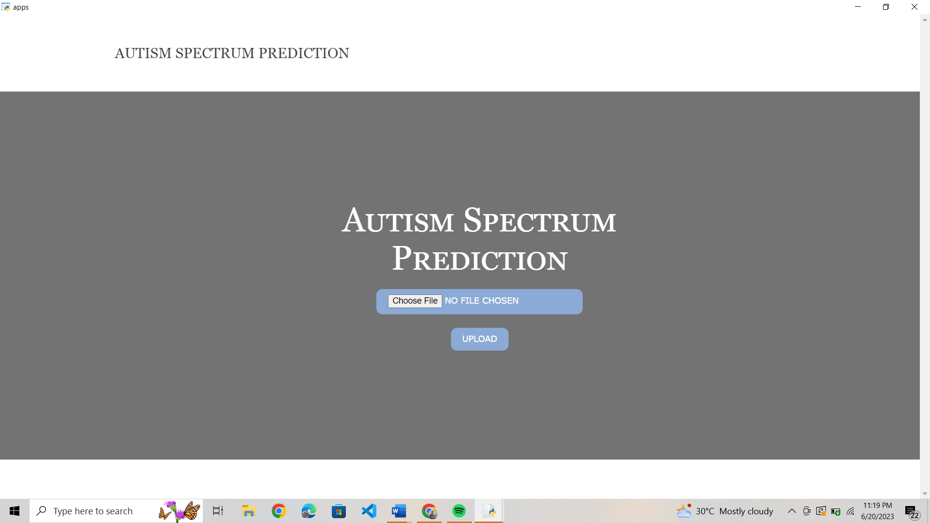
Dataset Page:-
Dataset page: In this page we upload the .csv file of the autism spectrum prediction.

Slide 28
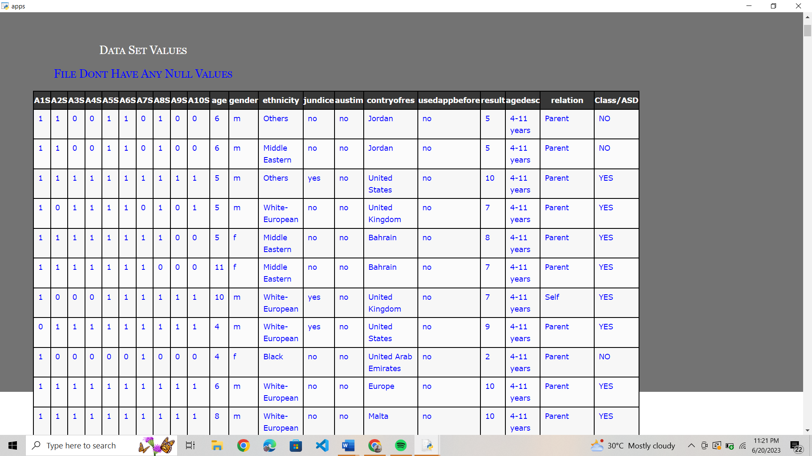
Dataset Page:-
Dataset page: The uploaded .csv file will be shown here and all attributes will be displayed.

Slide 29
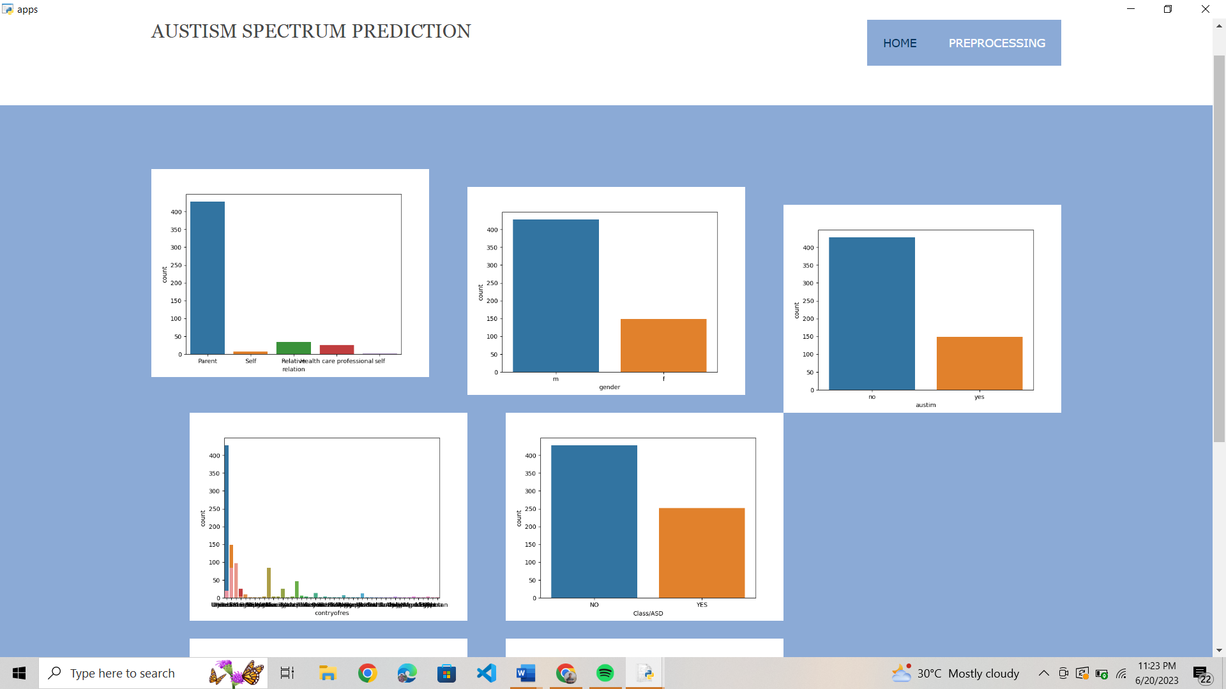
Graph Page:-
Graph page: Graphs of different attributes will be shown here.

Slide 30
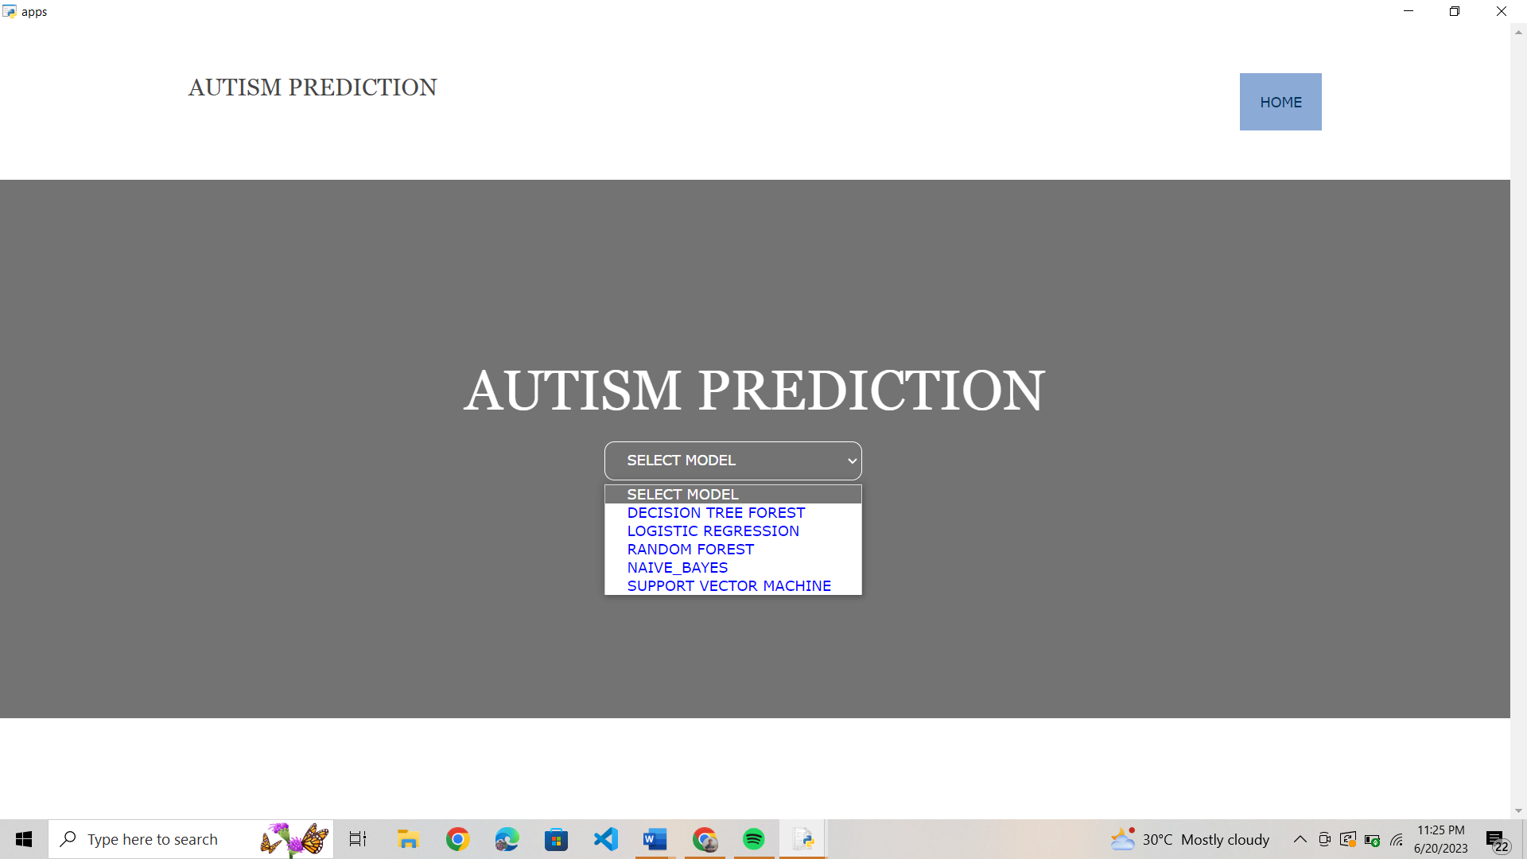
Model selection page:-
Model selection: In this we can select the required model.

Slide 31
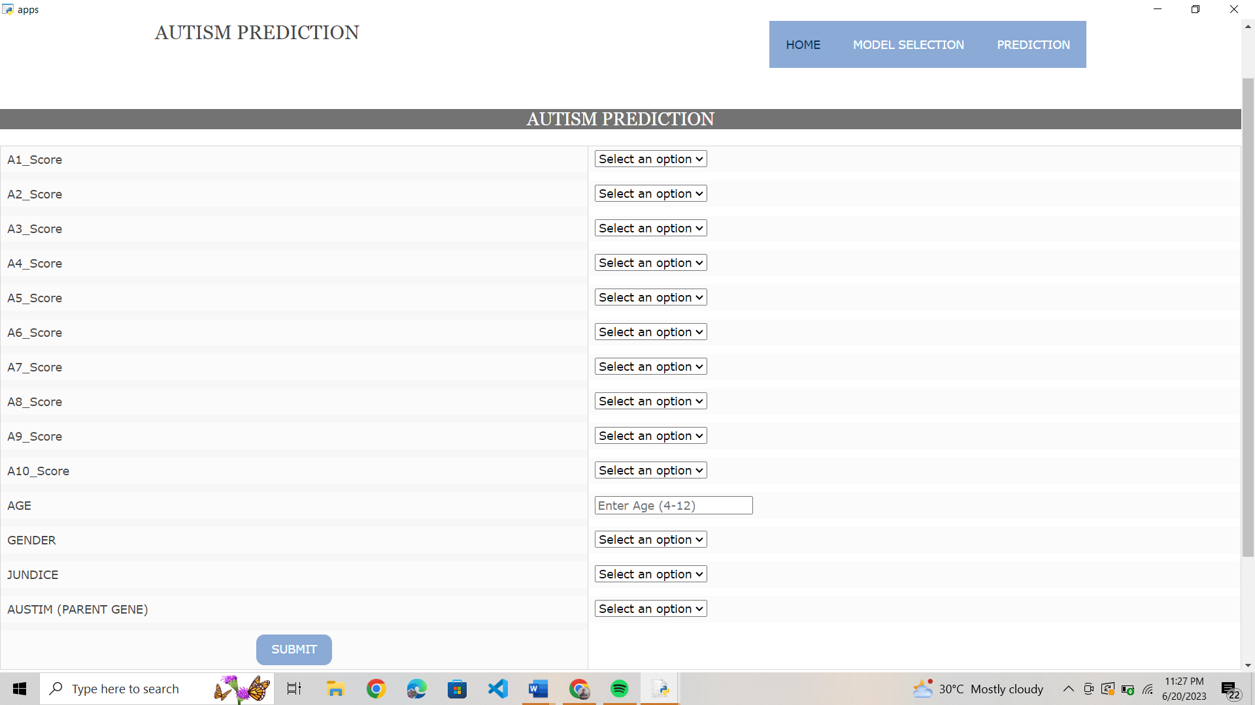
Prediction Page:-
Prediction page: In this we can give our input values to predict.

Slide 32
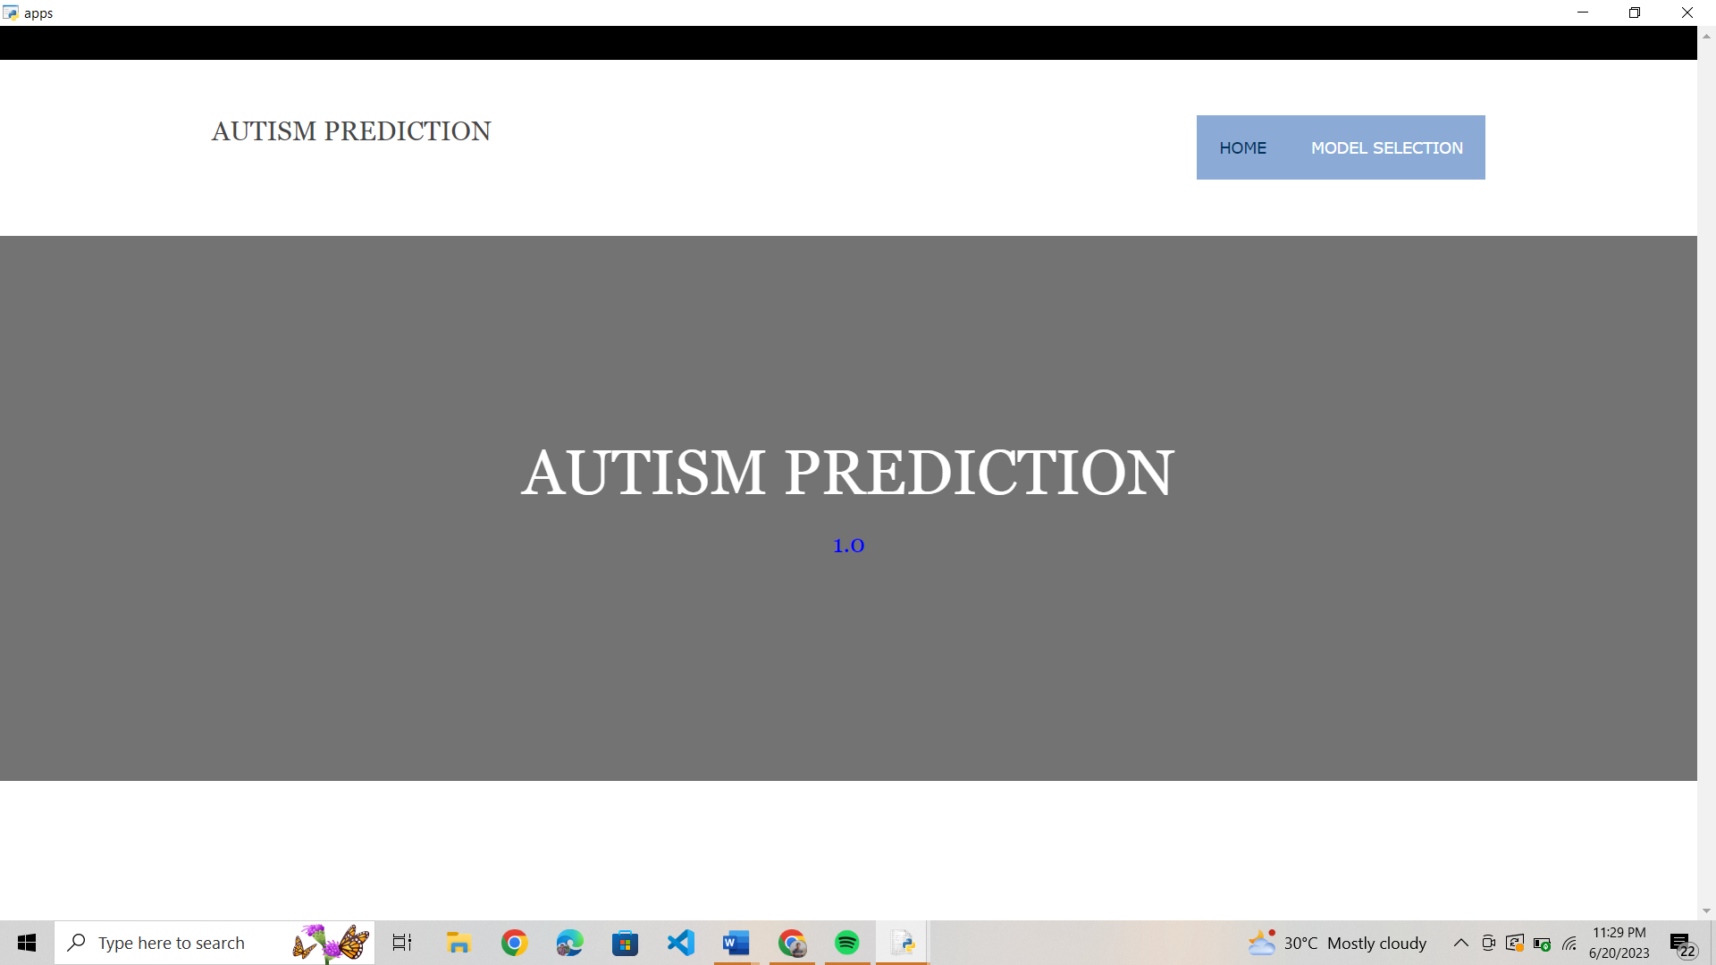
Output Page:-

Slide 33
CONCLUSION
Autism is one of the vital issues which cannot be prevented but can be treated and it’s a big challenge for any family to have a child with autistic disorder. Therefore, it’s importance to diagnose it, as early as possible. One of the major issues in today’s research is to have improved diagnostic tools to have faster, effective and accurate result. Machine learning techniques have shown favorable results. Machine learning with its leverage methods can be used to diagnose ASD. Use of machine Learning are to create algorithms that are vigorous and have contrive instruments. By using different ML algorithms researchers were able to build such model which shows improved results in terms of accuracy and precisions. In this analysis various classifiers have been used like SVM, Random Forest, decision tree, LMT, KNN, Naïve Bayes’, LDA and so on. Among all SVM have shown the best result with an accuracy of 98.27%.

